Slide 1
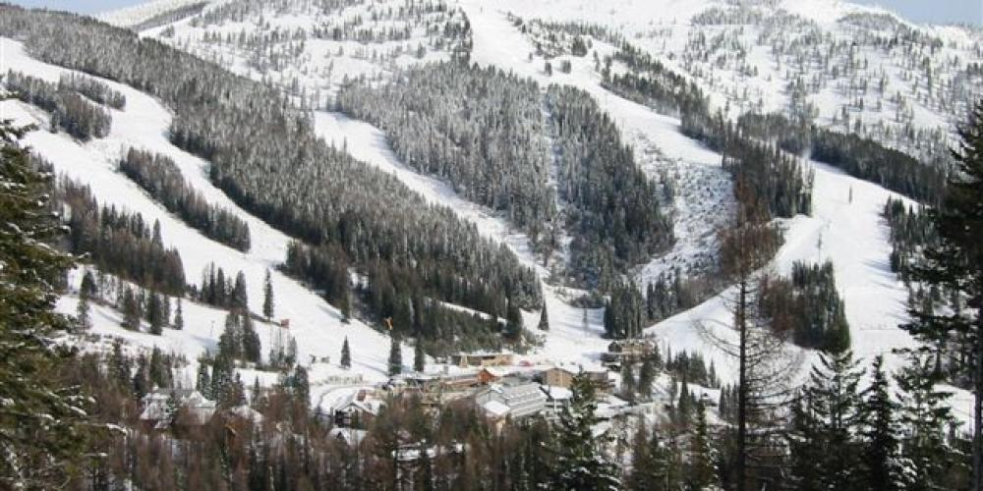
Select a better value for the ticket price of Big Mountain Resort
Andrew Chang
Aug 19, 2022
Source: https://explorewhitefish.com/

Slide 2
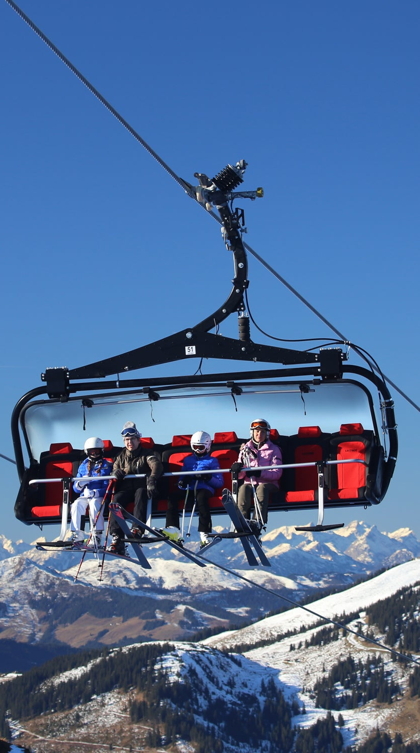
Problem
The new chair lift cost $1,540,000
Select a better value for their ticket price.
Increase the price, if supported by the facilities
Reduce facilities without undermining the price
Source: https://www.outsideonline.com/outdoor-gear/snow-sports-gear/most-luxurious-chairlift-world/

Slide 3
Recommendation & key findings
Increase the ticket price by $1
Sufficient to cover the additional cost within one season.
The facilities of Big Mountain resort support even higher ticket price
Up to $95.87
Our facilities outperform most ski resorts in the US.

Slide 4
Results and analyses

Slide 5
How to cover the cost of $1,540,000?
Expected visitors/season: 350,000
Expected tickets/visitor: 5
Increasing a ticket by $0.88 will cover the cost of $1,540,000 in 1 season.

Slide 6
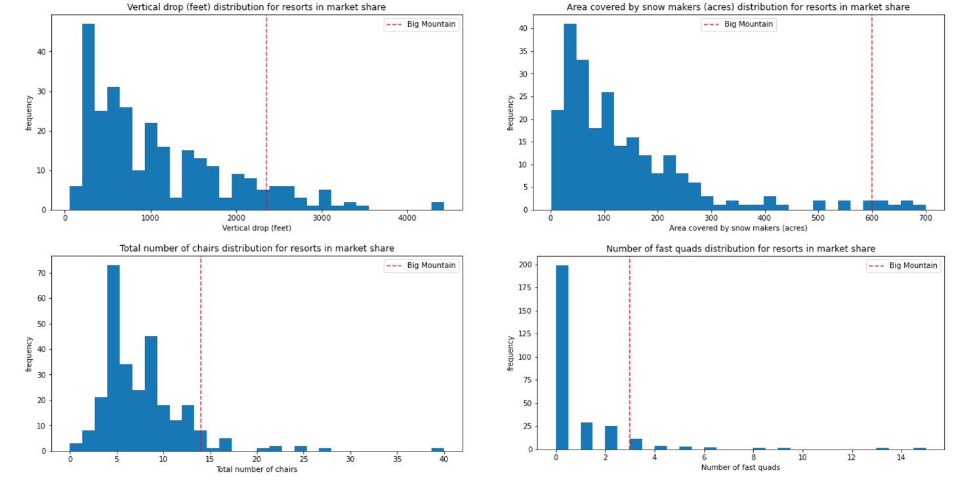
Our facilities are better

Slide 7

$95.87/ticket, supported by the facilities
The ticket price of a ski resort should be supported by its facilities.
Random Forest (RF) model
A machine learning approach
Model the relationship between facilities and ticket prices across all resorts in the US.
Use this RF model to estimate the supported ticket price of Big Mountain resort, based on its facilities.
$95.87/ticket, ± $10.39
Source: https://en.wikipedia.org/wiki/Random_forest

Slide 8
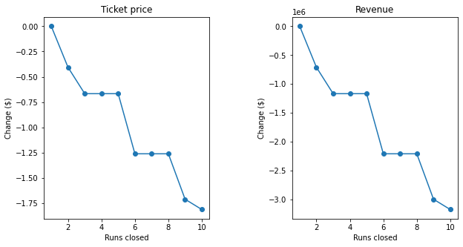
Add/remove facilities → ticket price?
The model enables us to estimate how adding or removing some of the facilities of the Big Mountain resort would change the supported ticket price and the revenue.

Slide 9
$95.87/ticket, will people buy it?
Limitation of the model: we don’t know how people will react to the price change.
They might not be aware of the quantity of our facilities.
No data on the relationship between number tickets sold and ticket prices

Slide 10
Summary & conclusion
Adding ticket price for $1 is sufficient to cover the additional cost.
Raising ticket price to $95 would be risky, as we don’t know how the customers will react to it.
Next season: model how the price change to $95 will affect the number of tickets sold, based on the data of the number of tickets sold before and after adding $1.

